Slide 1
Face detection Using Viola-Jones Algorithm
Eec 693
Group 19
Shubham Daule (2787739)
Shivani Phadtare (2787493)
Ramya Kakarla (2785312)

Slide 2


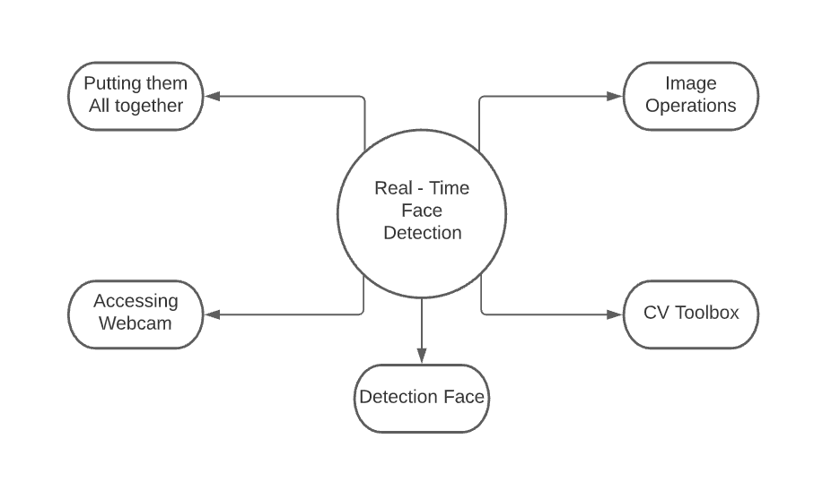

Slide 3

Introduction
Definition
History
How is face detection works?

Slide 4
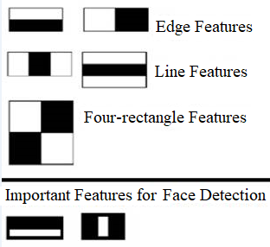
Viola-Jones Algorithm
Haar-like features selection.
Edge features
Line-features
Four-sided features
Creating an integral image.
Adaboost training.
Cascading classifiers.

Slide 5
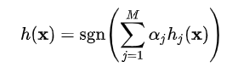
Viola-Jones Algorithm
Threshold Function Value
Cascade Architecture

Slide 6
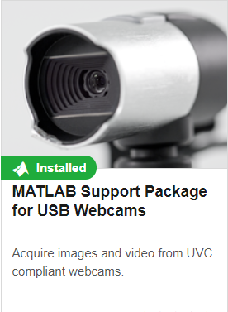
toolboxes required for project
Computer Vision Toolbox
Feature Detection, Extraction, Matching
Object Detection and Tracking
MATLAB Support Package for USB Webcams
Detect all available UVC-compliant Webcams
Configure Webcam properties in Windows and Linux.

Slide 7
Object Detector
Eyes, Mouth, Nose, Upper Body
DETECTOR = vision.CascadeObjectDetector (MODEl)
BBOX = step (DETECTOR, I);
Eyes, Mouth, Nose, Upper Body
Created using Vision.CascadeObjectDetector
M x 4 matrix [x y width height]

Slide 8
Object Detector
Ifaces = insertObjectAnnotation(I, ‘rectangle’, bboxes, ‘Face’);
Output Image
Image
Shape
Position
Label

Slide 9
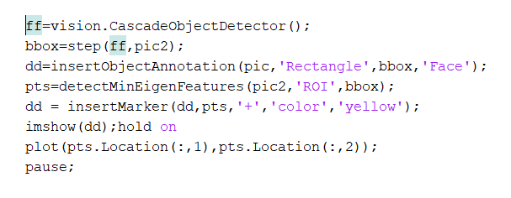
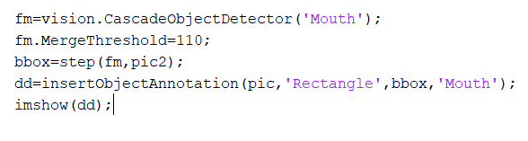
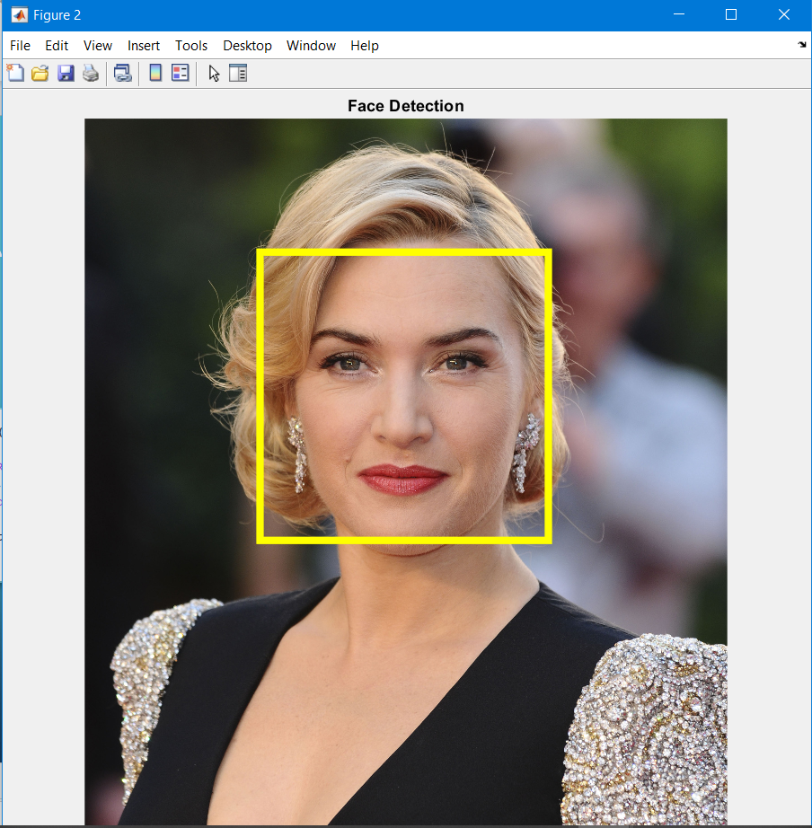
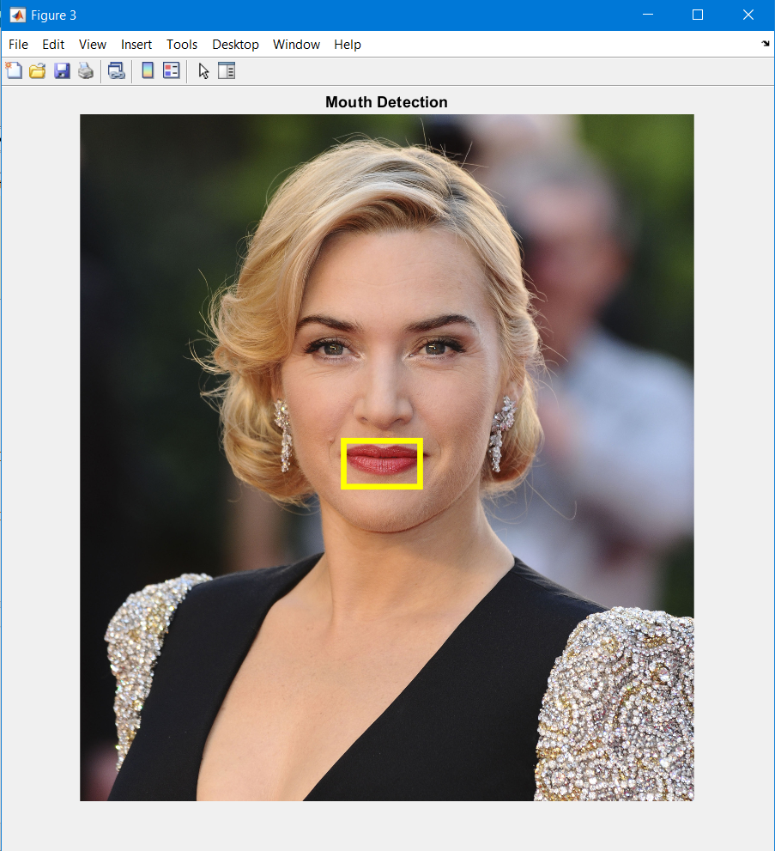
Program Parts & Outputs
Face Detection
Mouth Detection

Slide 10
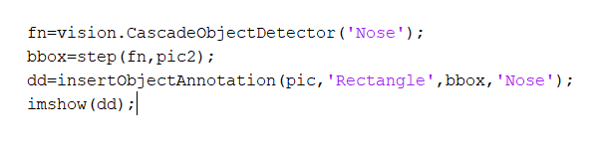
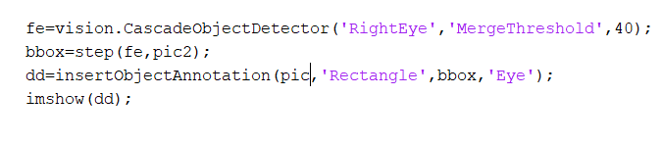

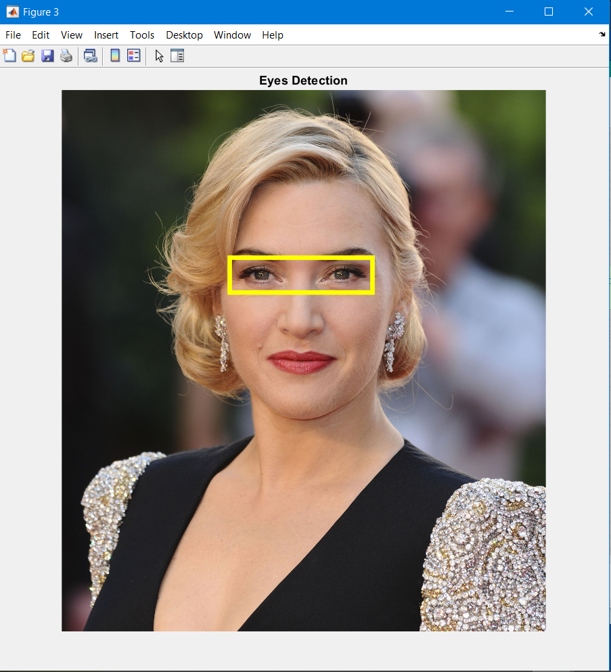
Program Parts & Outputs
Nose Detection
Eyes Detection

Slide 11
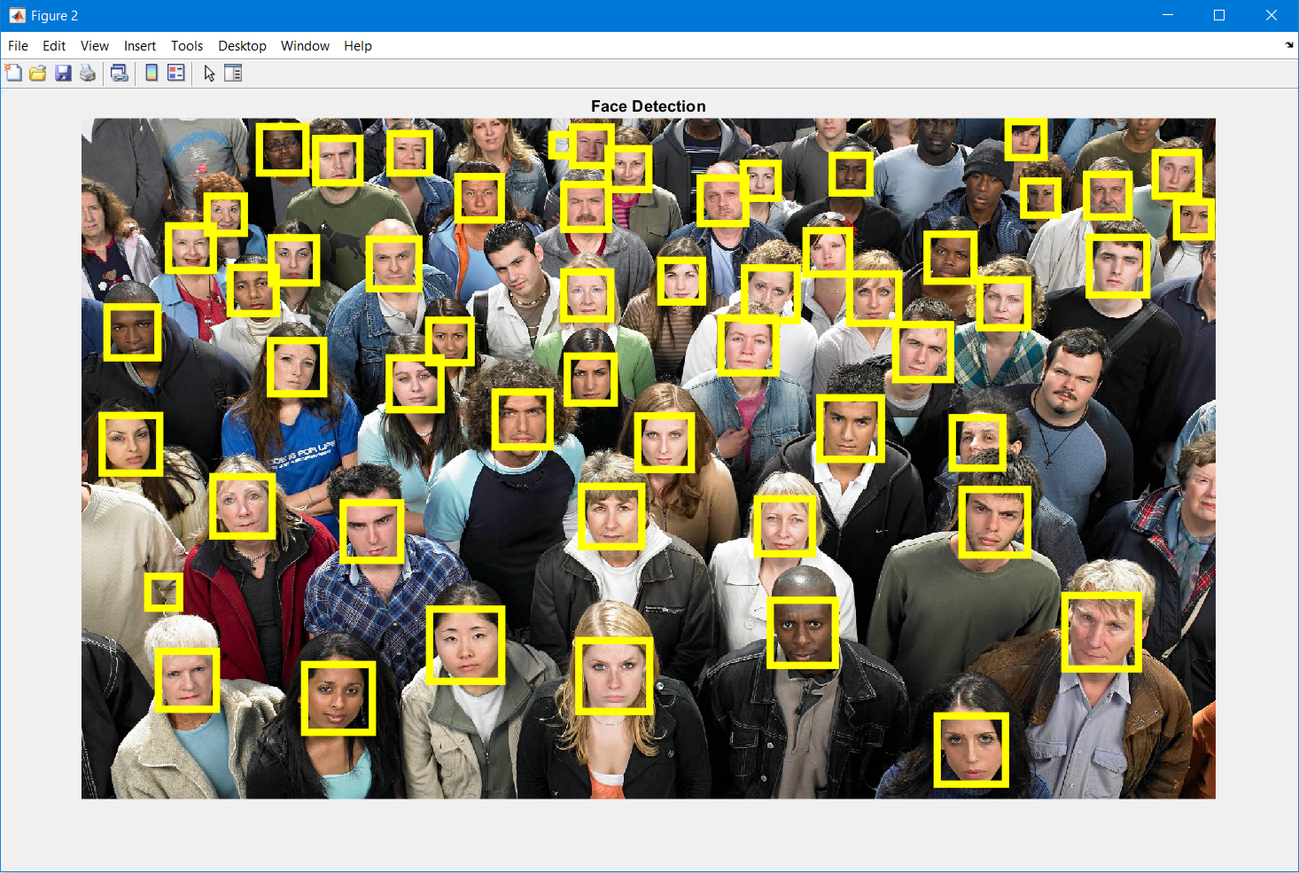
Program Parts & Outputs
Multiple Face Detection

Slide 12
Accessing Webcam
Command to show Webcam properties:
web = webcam , webcamlist
Command to access Webcam:
web = webcam (‘HD Camera’);
video = videoinput(‘winvideo’,1); preview(video);
Command to show Webcam snapshots:
web = webcam , webcamlist

Slide 13
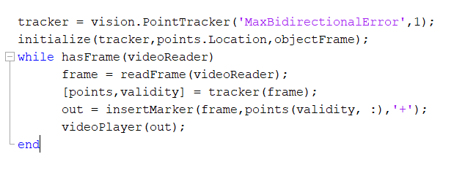
Program for webcam

Slide 14
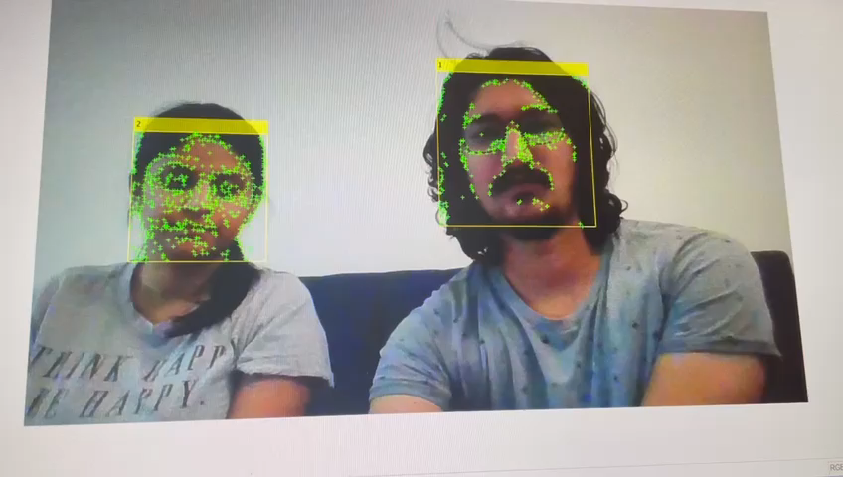
Multi-face detection output

Slide 15
Summary

Slide 16
Thank You

